Slide 1
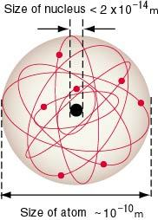
The Nuclear Atom
Notes:
THIS IS RUTHERFORD, NOT B-R model (no discrete orbitals yet)

Slide 2

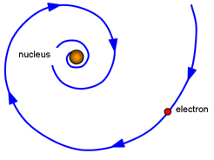




Nuclear Atom Limitations
Notes:
electrons use energy to move so what prevents them from collapsing into the nucleus due to attraction
some electrons sit far from the nucleus so what prevents them from overcoming the attractive pull of the nucleus and escaping
like charges repel and positive protons are confined to small space of the nucleus so what force is overcoming the immense force of repulsion

Slide 3
Limitations
This is in words for those away. Numbers match pictures on previous slide:
1. Because of opposite charges, under Rutherford’s model, electrons should be attracted to, and collapse into, the nucleus
2. Electrons are fast moving, those far enough away should just fly off (what’s holding them once attraction of nucleus is weak due to distance?
3. What holds the nucleus together when particles all have a positive charge (and should repel)?

Slide 4
Bohr-Rutherford Atom
attempts to deal with these issues
observed heated elements produce distinct colours
a prism reveals a unique individual colours called a line spectrum
differs from continuous (full) spectrum of white light

Slide 5
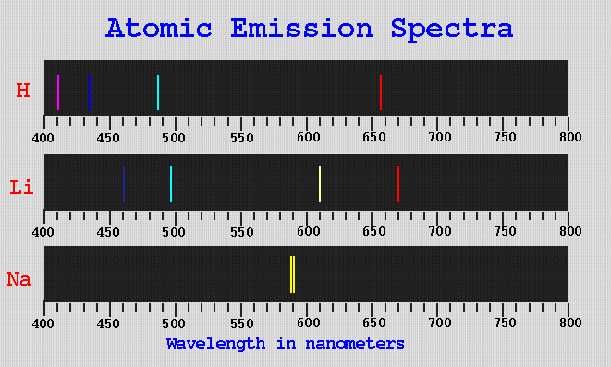
Bohr-Rutherford Atom

Slide 6
A volunteer & a chair

Slide 7
Bohr-Rutherford Atom
proposed that electrons are confined to distinct energy levels at fixed distances from the nucleus
thus, electrons within a level have the same energy and electrons do not exist between levels
levels increase in energy moving away from the nucleus

Slide 8
Bohr-Rutherford Atom
if an electron absorbs energy, it moves to higher level (excited state)
when the electron loses some energy it must move back to its original level (ground state)
as a result it releases excess energy in the form of light seen as a line

Slide 9
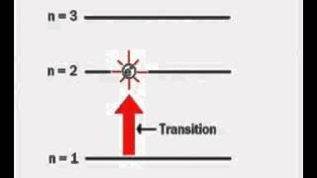
NOTE: The ground state is the electron position in a neutral atom as you would draw it in Bohr. So an electron’s ground state could be n= 1, 2, 3, 4, etc.

Slide 10
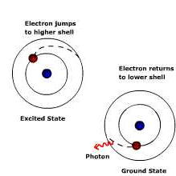
Bohr-Rutherford Atom

Slide 11
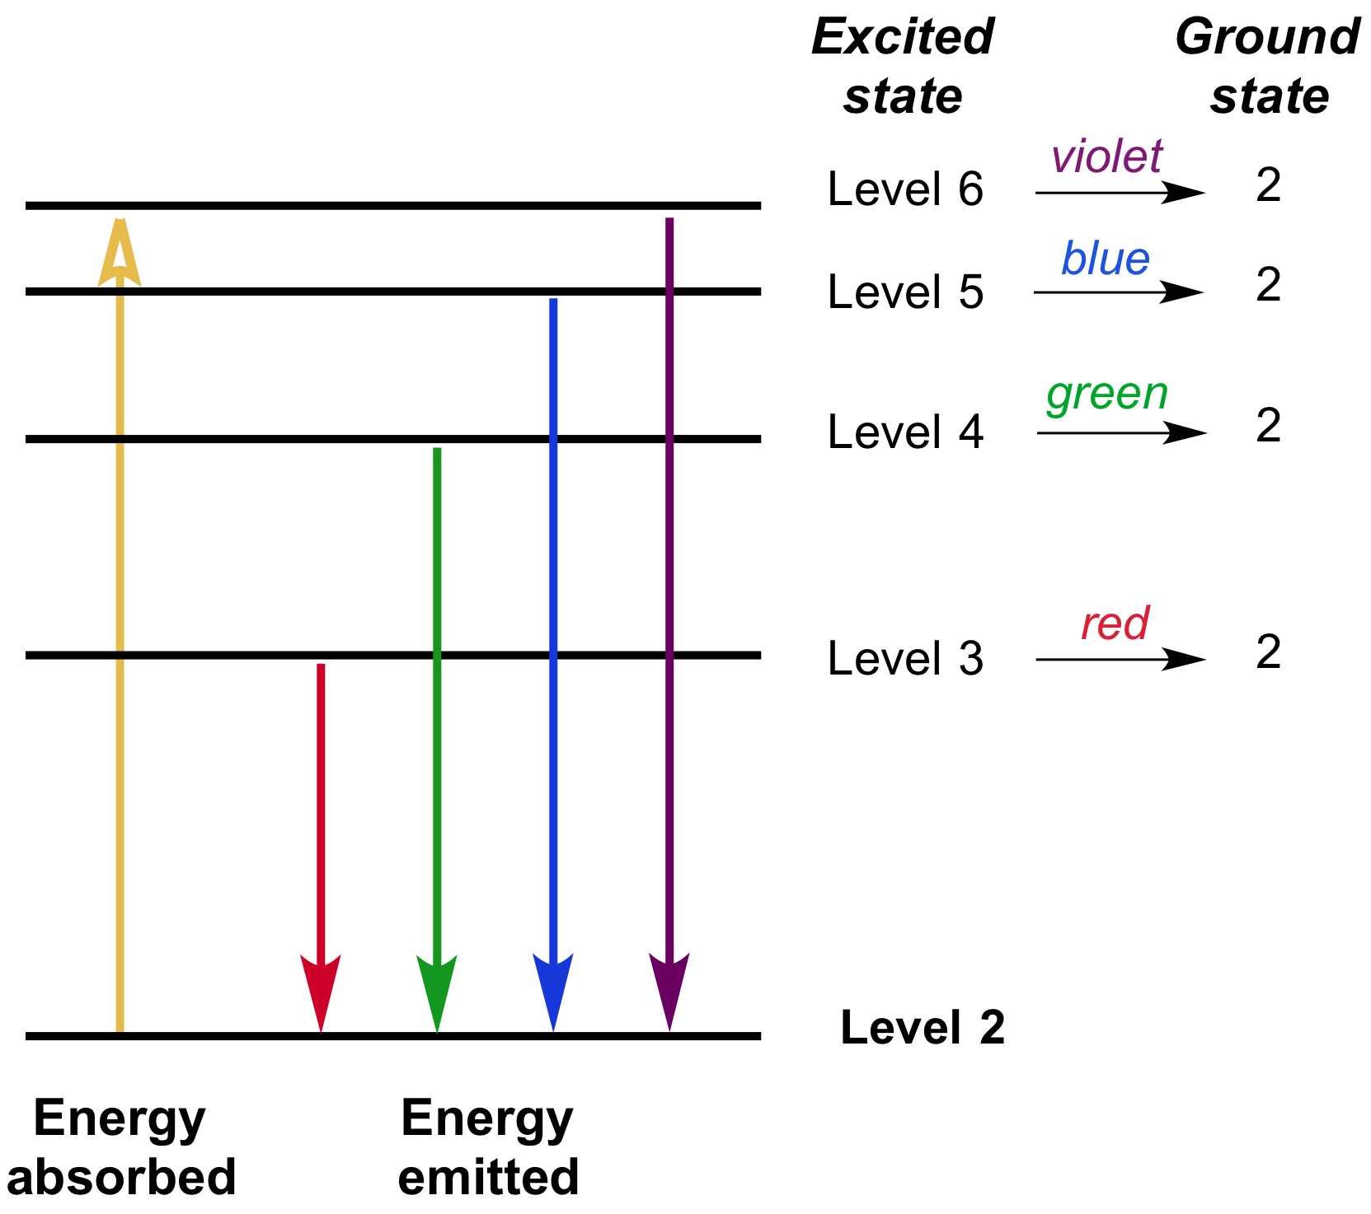
Spectroscopy: Interaction of light and matter (article) | Khan Academy

Slide 12
Bohr-Rutherford Atom
used H atoms as their model
found that electrons always occupy lowest possible energy level (Aufbau principle)
found that maximum number of electrons for each energy level is given by 2n² where n is level number so level 1 has 2 electrons, 2 has 8 electrons, 3 has 18 electrons

Slide 13
Bohr-Rutherford model is 3D
We draw it 2D BUT all researchers understood the atom was 3D since matter is 3D. So Bohr’s model, Rutherford’s and the upcoming quantum model are all 3D!!
3D Bohr animations
Radium 3D (move it to get 3D rotation of levels)

Slide 14
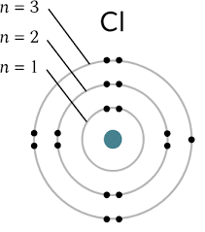
Bohr-Rutherford Atom
draw the nucleus indicating the number of protons and neutrons present
draw energy levels to hold electrons for that level and after each level is full draw a new level further from the nucleus

